Slide 1

Phishing

Slide 2
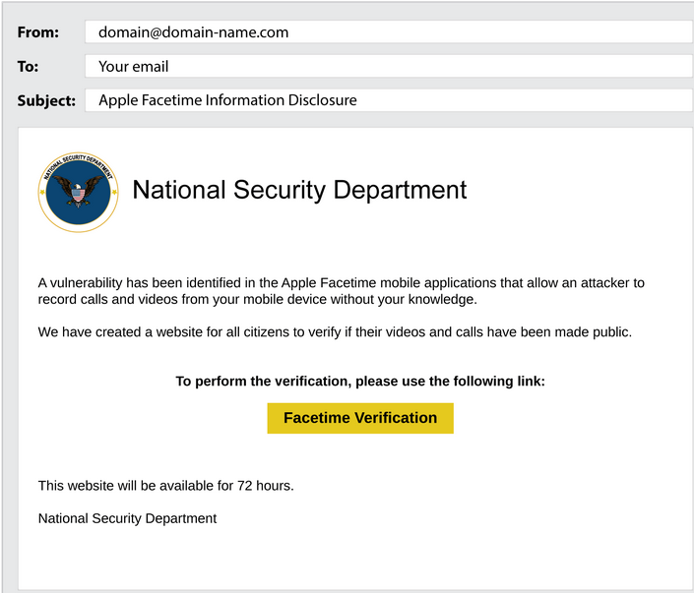
Common methods used by attackers
Pretending to be someone else
Prey on your curiosity
Using a fake sign in page
Offering something too good to be true

Slide 3
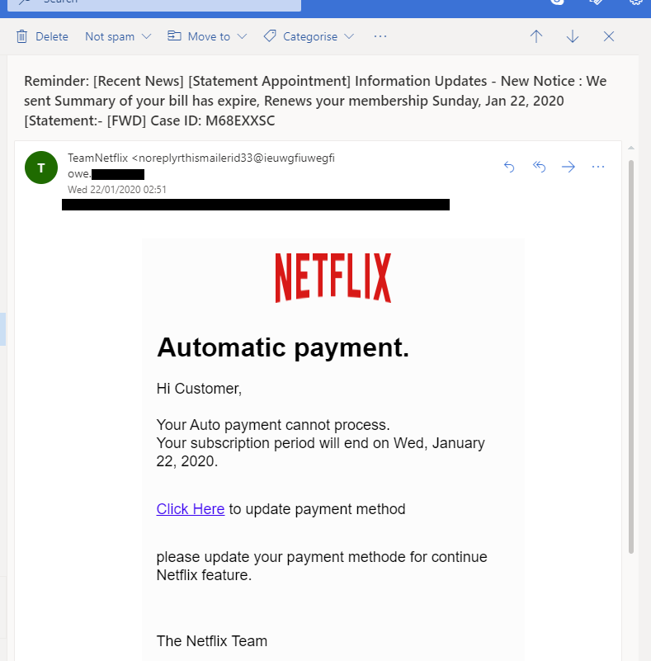
Common signs of phishing
Altered website links
Fake emails
Poor spelling or grammar

Slide 4
What to do if you see a phishing message
Don't open the message, contact the sender through a different medium
If you think something is fake treat it as such
Tell people so others know about the phishing campaign

Slide 5
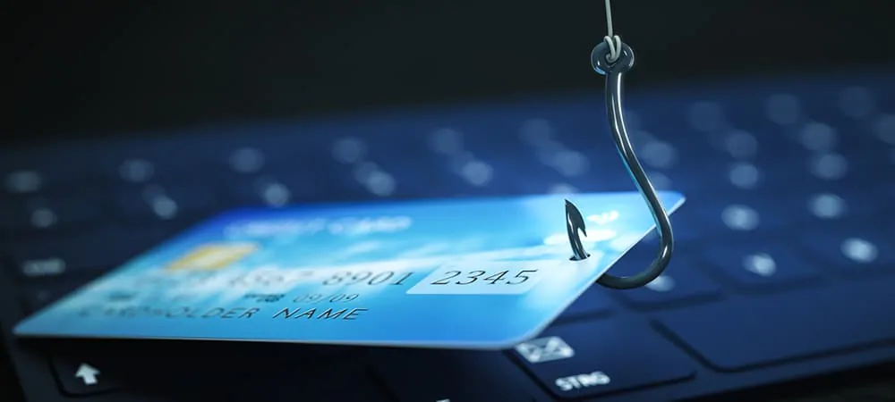
What to do if you think you have been phished
Change any username and passwords that the attacker may have stolen
If they took your credit card information contact your bank
Make sure all information that was stolen is rendered useless

